Slide 1


Presenters:
Rich Schornstein, Mike Armstrong, Roger Burbage USATF Annual Meeting, December 2015

Slide 2
Smaller Local Meets
Pre-season
Recruit new officials
Update officials’ database
Schedule & conduct training; send rules updates
Confirm meet dates for season w/meet director
Confirm benefits w/meet director – stipend, tickets, clothing, etc.
Send info & meet dates to officials; ask for availability/commitment; thank them

Slide 3
Smaller Meets (Cont’d)
Pre-meet
Make assignments – heads & crews
Seek additional officials
Coordinate w/meet director regarding:
  Support items - meals, equipment, parking, volunteers, fluids at venues, etc.
  Competition items - warm-up times, numbers to finals, event sheets, etc.
Send to officials: meet schedule, assignments, reporting times; thank them
Don’t forget lap counters

Slide 4
Smaller Meets (Cont’d)
Meet day:
Arrive early - check equipment, safety; help set up venues; get event sheets to heads; check on meals
Make last-minute assignment changes
How goes it at all venues, get needed equipment; thank them
Probably fill in on a crew as needed
Maintain record of officials working the meet

Slide 5
Smaller Meets (Cont’d)
Post-season:
Authorize payments to officials; distribute clothing, tickets, etc. if applicable
Manage officials’ awards -- nomination, selection, & presentation if applicable; thank them
Other:
Use elements from “Larger Meets” discussion & the Best Practices document, as appropriate for your circumstances

Slide 6
Larger Championship Meets
  Large number of officials, many from out of state
  Typically multi-day meets
  Usually a governing body is involved
  Critical to plan well in advance of the meet – with meet management, Games Committee, Referees, host coach, facilities, volunteers, …

Slide 7
Larger Meets (cont’d)
Pin down the basics -- get agreement on:
Coordinator’s duties
  Applications – creation, distribution, posting to websites, receipt
  Selections & assignments
  Site visit, review of venues & equipment
  Info for officials on conducting events
Officials’ matters
  Max number of officials
  Benefits – stipend, lodging, meals, clothing, …

Slide 8
Larger Meets (cont’d)
  See the “Officials’ Coordinator Planning” Best Practices document at: my.usatfofficials.com/resources
  Questions for Games Committee/Meet Director
  Topics typically covered at officials’ meeting, though not all are consistently addressed there
    Pose the questions & get the answers far in advance
    Ensure critical info is in Participant’s Manual
    Put needed officials’ info on a sheet; send to all officials or handout at meeting
  Tips for coordinators

Slide 9
Coordinator’s Duties
  Communication with Officials
  Keep them informed, keep them enthused
  E-mails: invitation to apply, selection notice, updates
  Info for all officials:
  Meet location, meet schedule, assignments, lodging, meals, uniform, check-in, officials’ meeting, credential & clothing pickup, payments
  Info for events heads:
  Crew contact info, safety, equipment to bring, rulebook, event head officials protocols (from Best Practices)

Slide 10
Coordinator’s Duties (Cont’d)
  Officials Matters
  Meals – which meals, which days, location, hours, menu, box meals to take to venues?
  Lodging – where, what nights, who reserves, how many rooms for officials?
    Which officials eligible; single or double occupancy; can one pay for a single/bring spouse
    Confirm required dates with officials & w/meet mgmt
    Notify officials – hotel, location, website, parking, etc.

Slide 11
Coordinator’s Duties (Cont’d)
  Safety – Coordinator (and Referee) check crowd control, overlap of venues; condition of pits, rings, cages, runways, track surface, curb, hurdles & barriers, SC water jump
  Volunteers – essential to augment crews; best to have a separate volunteer coordinator; ID required numbers & duties

Slide 12
Coordinator’s Duties (Cont’d)
  Equipment
    The big stuff (pits, hurdles, etc.) – is it all functional?
    Smaller items for officials’ use (flags, rakes, clipboards, etc.) – are they on hand?
  See Best Practices equipment spreadsheet
    Pin down the host on all items
    Check everything during site visit
    Items at venue or crew gets them from _____?
  Much more … see the Planning sheet

Slide 13
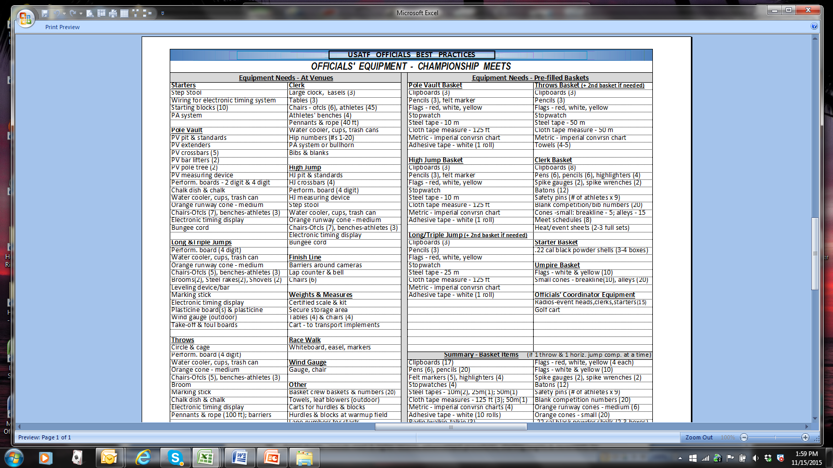

Slide 14
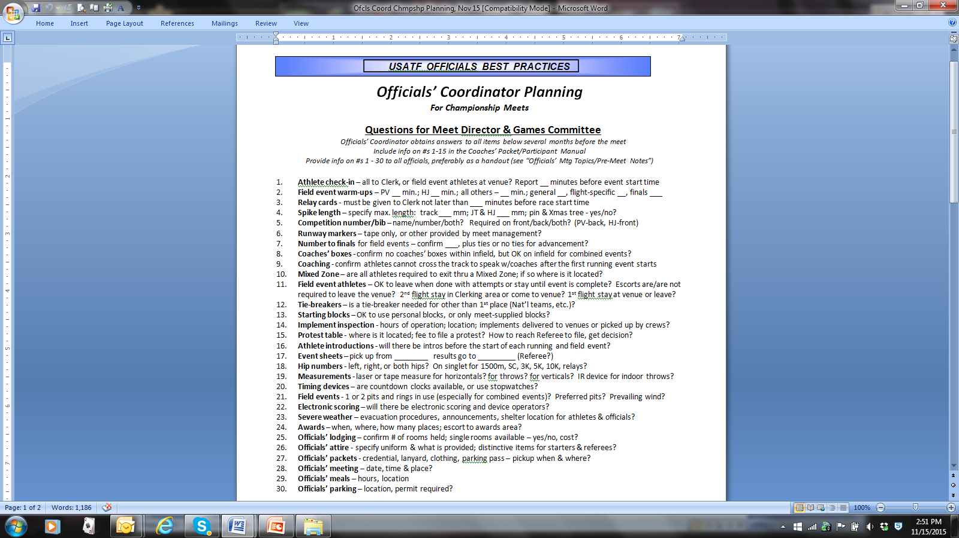

Slide 15
What Can Go Wrong?
Officials cancel – early & late; no-shows
Games Committee questions not answered
Equipment problems
Officials’ problems – meals, clothing, lodging/roommates, payments
Volunteer problems/no-shows
Severe weather – suspend/delay/reschedule
And, much more …

